Slide 1
Team Echo-o-o
Group Presentation
For CS 325
Members: Brian Olsen, Brendan Lehman, Lindsey Shelton
Notes:
//Welcome :]

Slide 2
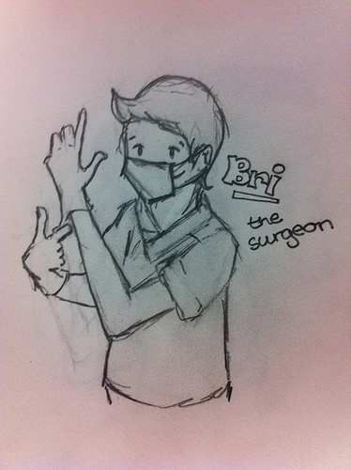
Meet & Greet
Brian Olsen – ‘The Surgeon’
Mission:
Architectural Engineer
System Analyst
“The Designer”
Notes:
//Lindsey Introduces, Brian Talks

Slide 3
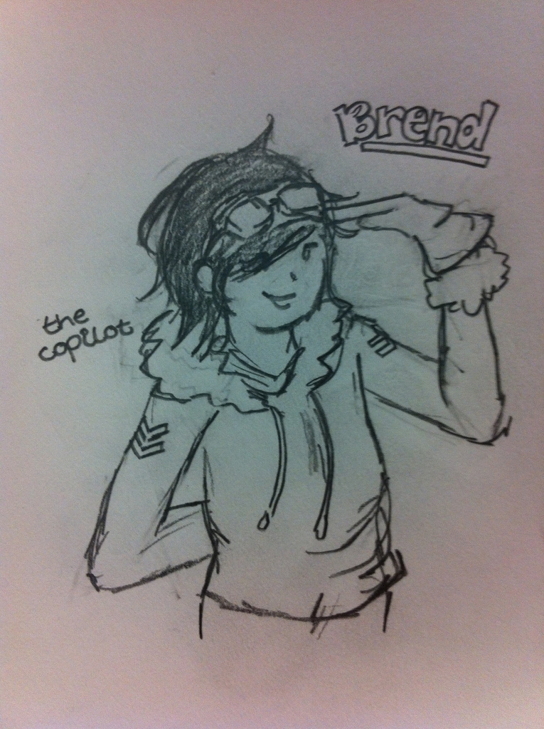
Meet & Greet
Brendan Lehman – ‘The Copilot’
Mission:
Brian’s Alter-Ego
Put Ideas into Words
“The Scribe”
Notes:
//Lindsey introduces, Brendan Talks

Slide 4
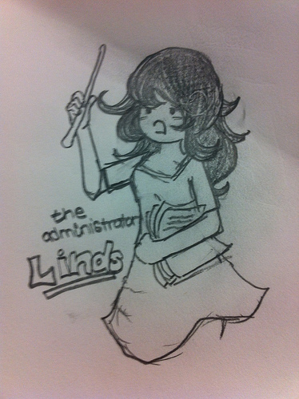
Meet & Greet
Lindsey Shelton – ‘The Administrator’
Mission:
Document all the Things
Schedule all the Tasks
“The Manager”
Notes:
//Lindsey

Slide 5
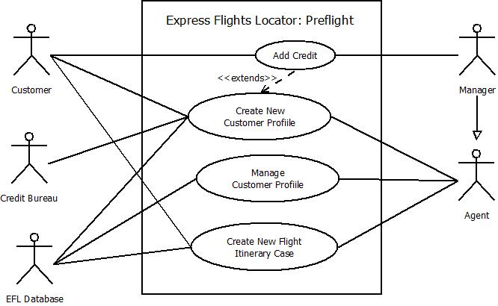
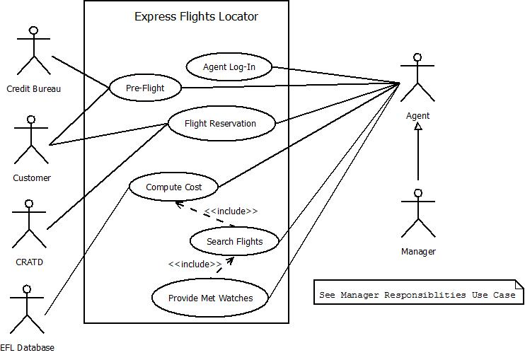
Use Case Diagram(s)
Notes:
//Brendan
//Final use case diagram(s) and requirements management.

Slide 6
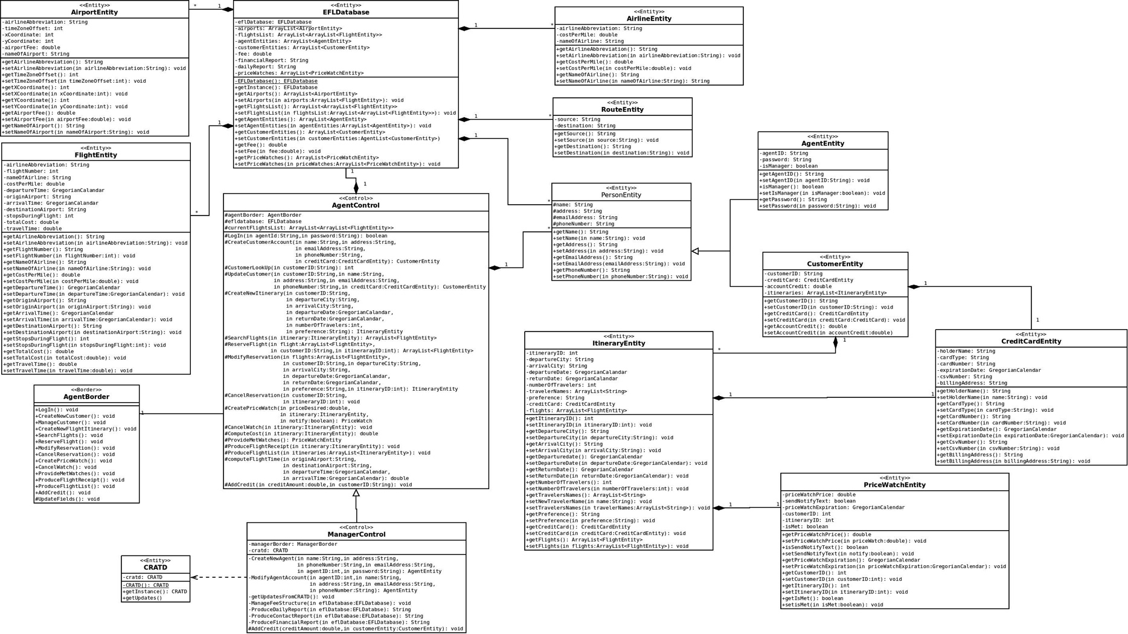
Class Diagram
Notes:
//Brian
//Final class diagram(s) and design elements.

Slide 7
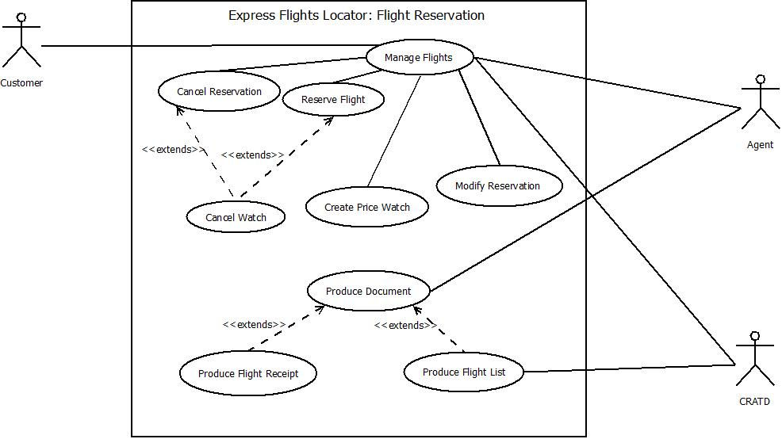
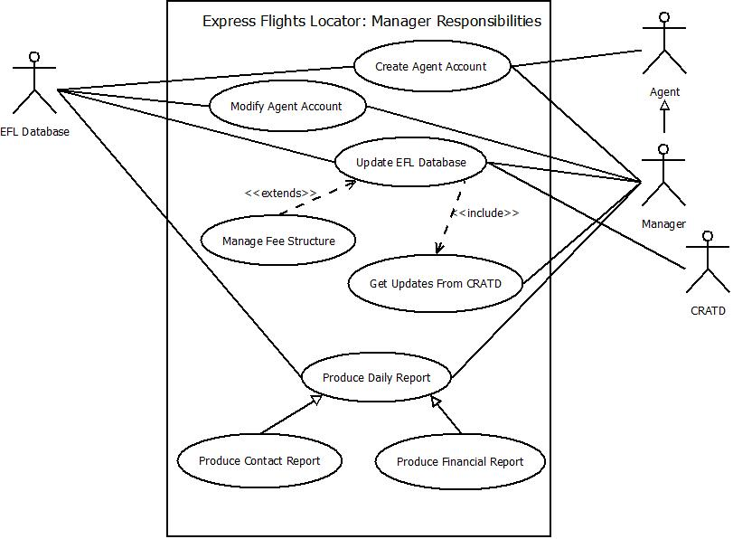
Use Case Diagram(s)
Notes:
//Brendan

Slide 8
Requirements Management
How well did we meet our goals?
Use-Case Diagrams vs. Customer Requirements
Creating The Use-Cases w/ Noun Extraction
Planning w/ Estimated Task Times
Notes:
//Lindsey
//Noun Extraction for Creating Class Diagram

Slide 9
Requirements Management
How well did we follow our SPMP?
Making a basic plan helped relieve the balance/workload for our team throughout the timeline.
Estimation helped with configuring this balance of the workload.
We kept our roles constant, as it made splitting tasks easier for our levels of expertise.
Notes:
//Lindsey Talks,

Slide 10
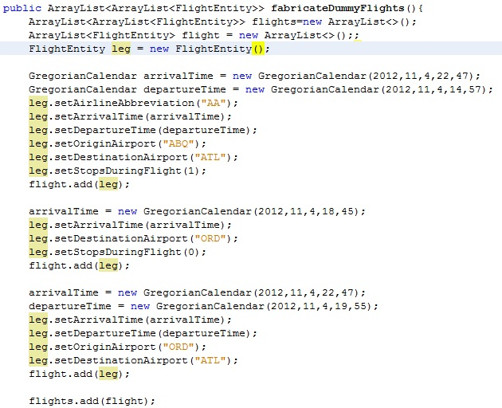
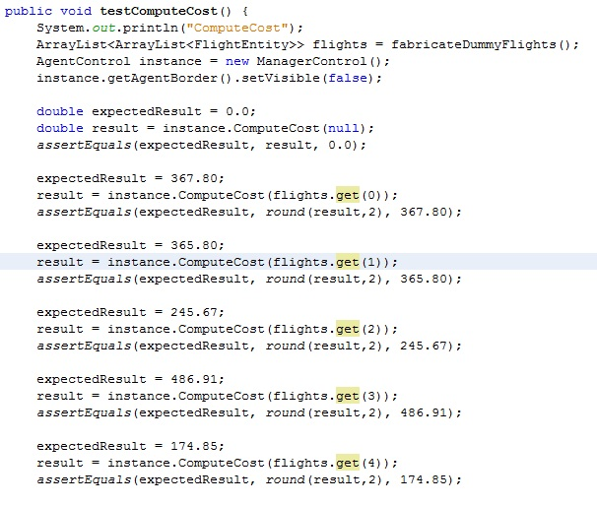
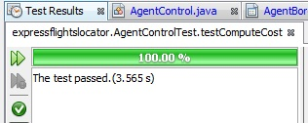
Coding & Testing
JUnit Testing
Black-Box Testing
Border Testing
Integration Testing
Currently we are doing Unit Testing, with Integration Testing to Follow.
Black-Box Testing and Border Testing via JUnit
Notes:
//Junit Testing Pics – Need from Brian!!!!!!!!!!!!!!!!!!!!
//Brian
//Coding and testing approach. How well did your code follow your design (class diagrams and sequence diagrams)? What tests are you conducting to ensure correctness?
Our team is mostly focusing on testing the individual units, a much smaller degree of integration testing.
We are mostly interested in how the classes interact with one another.

Slide 11
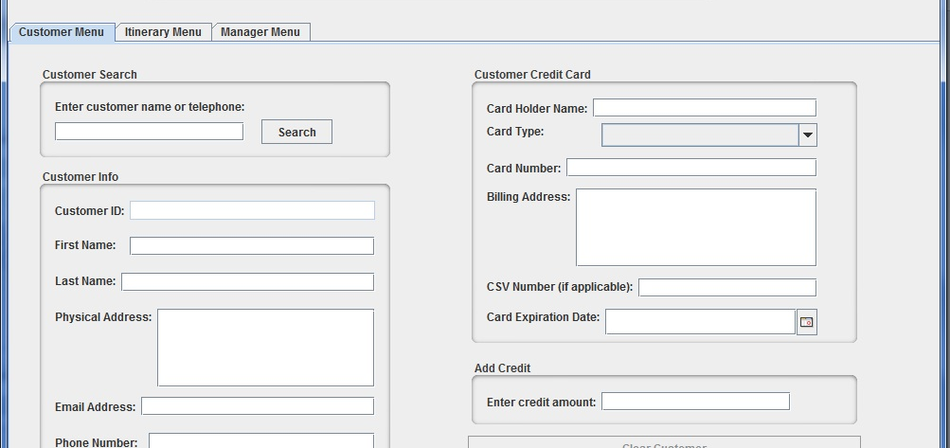
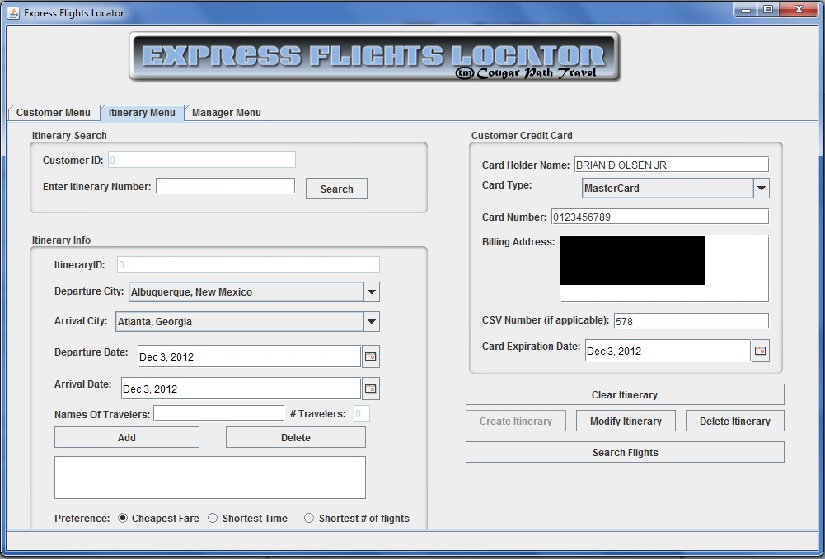
GUIs
Customer Menu
Search and Display is Integrated
Itinerary Form
Determinant on Previous Customer Input
The Location Drop Downs are Populated by CRATD Update
Notes:
//Brian
Login: agent id: admin
Cust Lookup: cust searchbar: brian
Itenerary: 0 – itinerary ID

Slide 12
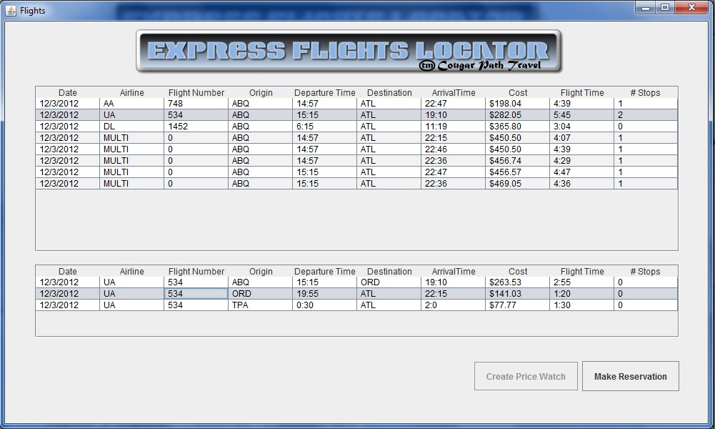
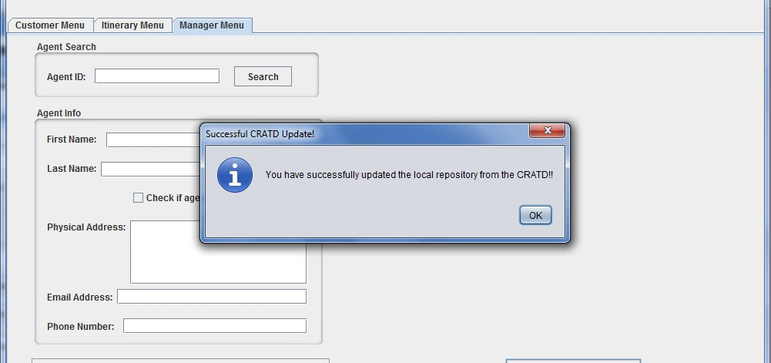
GUIs
Flights
Main Flights on Top
Legs on Bottom
CRATD Update
Used Proxies to Report Successful Operations or Errors Throughout the GUI
Notes:
//Brian

Slide 13
Post-Mortem : The Good
Let’s Get Together, yeah yeah yeah!
We had similar schedules and were able to meet often.
We are Fam-il-yyy!
Our team has had previous experience working together.
We got along and knew each other’s strengths and weaknesses.
Go go Power Rangers!
Because we assigned tasks according to our strengths, we were able to power through the implantation of our project.
Notes:
//Lindsey
Overall, our team has worked rather well in balancing one another. Brian and Brendan have had a rather long history of working together on previous projects, and therefore had a strong team membership background prior to this project.

Slide 14
Post Mortem : The Bad
Is this real life? Is this just fantasy?
Our level of knowledge and experience was limited at the beginning of each project.
We were able to improve on this through practice and questions.
You say black, I say white.
In the early stages of the project, communication was an issue.
Meeting face to face was more of an issue than through phone, text, or email.
Communication improved when we implemented team meeting notes.
Notes:
//Lindsey

Slide 15
Fin
[ The End ]
<3
Notes:
//Done

